Slide 1


Presentation Title
Name of presenter

Slide 2

SAMM Sessions – Generic DevOps Security Maturity Model (GDOSMM)
No need to change the core model but reviewing the SAMM activities is important to assure they are implementation neutral
In addition Implementation advice can be included for different roles and processes e.g. DevOps, Waterfall and Agile
GDOSMM is a potential implementation subset of SAMM
An evening session was agreed for model mapping SAMM to GDOSMM
The effort/impact dimensions suggested make for an interesting addition to activities

Slide 3
SAMM Sessions – Core Model Update 2 – Developer Methodology
Restructure SAMM activities with an increasing maturity of implementation
Apply this restructure to all SAMM practises and activities (high level).
Create one or more detailed descriptions with implementation guidance

Slide 4
SAMM Sessions – OWASP Project Alignment
We must make sure to remap “Flagship” and “Lab” projects for SAMM Version 2
Reach out to “Flagship” and “Lab” leaders to get references to the SAMM project and, if possible, link to an activity or security process.
Identify missing tools and artefacts that are needed for different activates
Make sure to promote these missing tools and artefacts to encourage people to undertake the project themselves.
Map a lower level of granularity; map at a level of activities

Slide 5

Today’s schedule
10:00– 09:30 | Session
09:00– 09:30 | Session
09:00– 09:30 | Session
09:00– 09:30 | Session
09:00– 09:30 | Session
09:00– 09:30 | Session
09:00– 09:30 | Session
09:00– 09:30 | Session
09:00– 09:30 | Session
09:00– 09:30 | Session
09:00– 09:30 | Session

Slide 6

Join the conversation

Slide 7
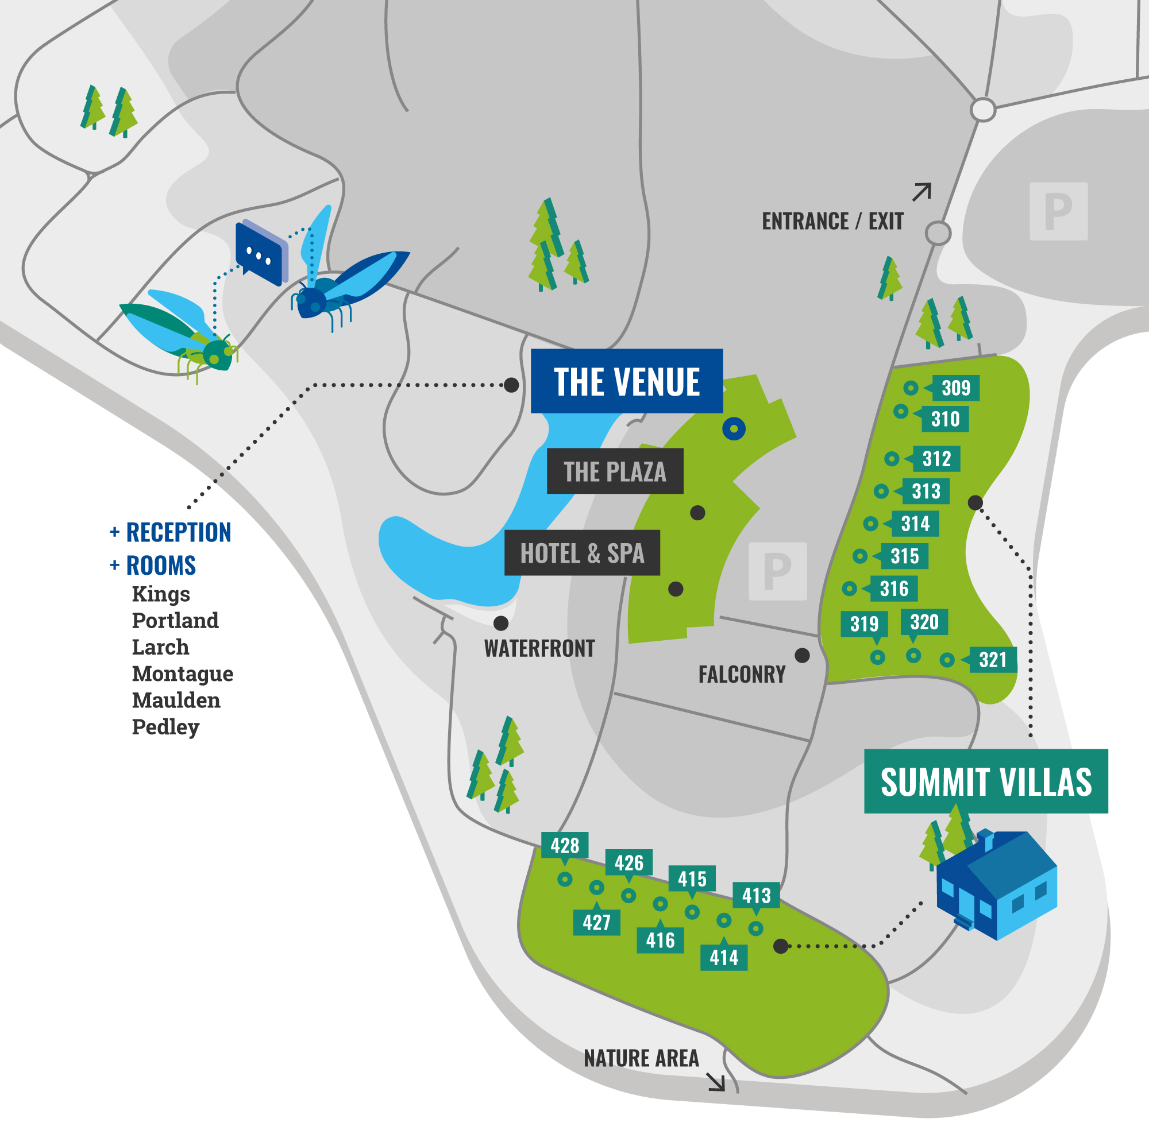
OWASP Summit Village map

Slide 8






Slide 9

Thank you! Questions?

